Slide 1


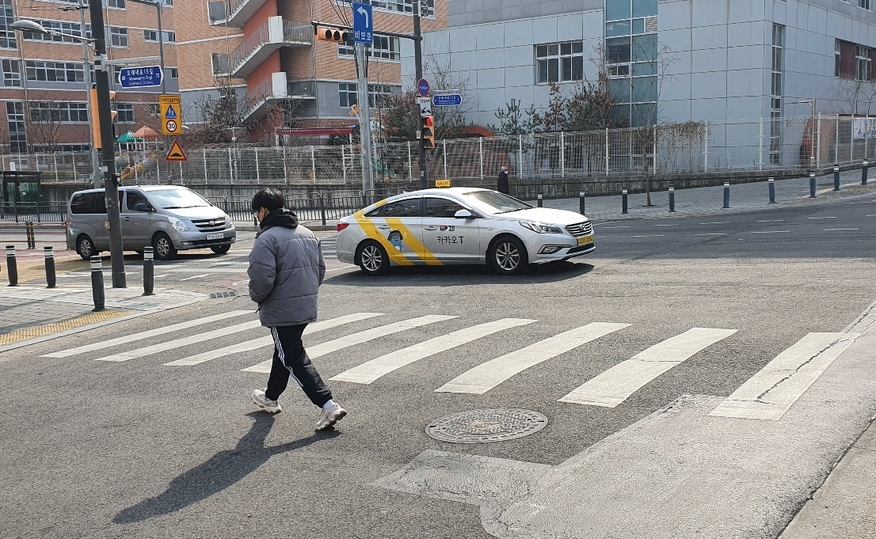
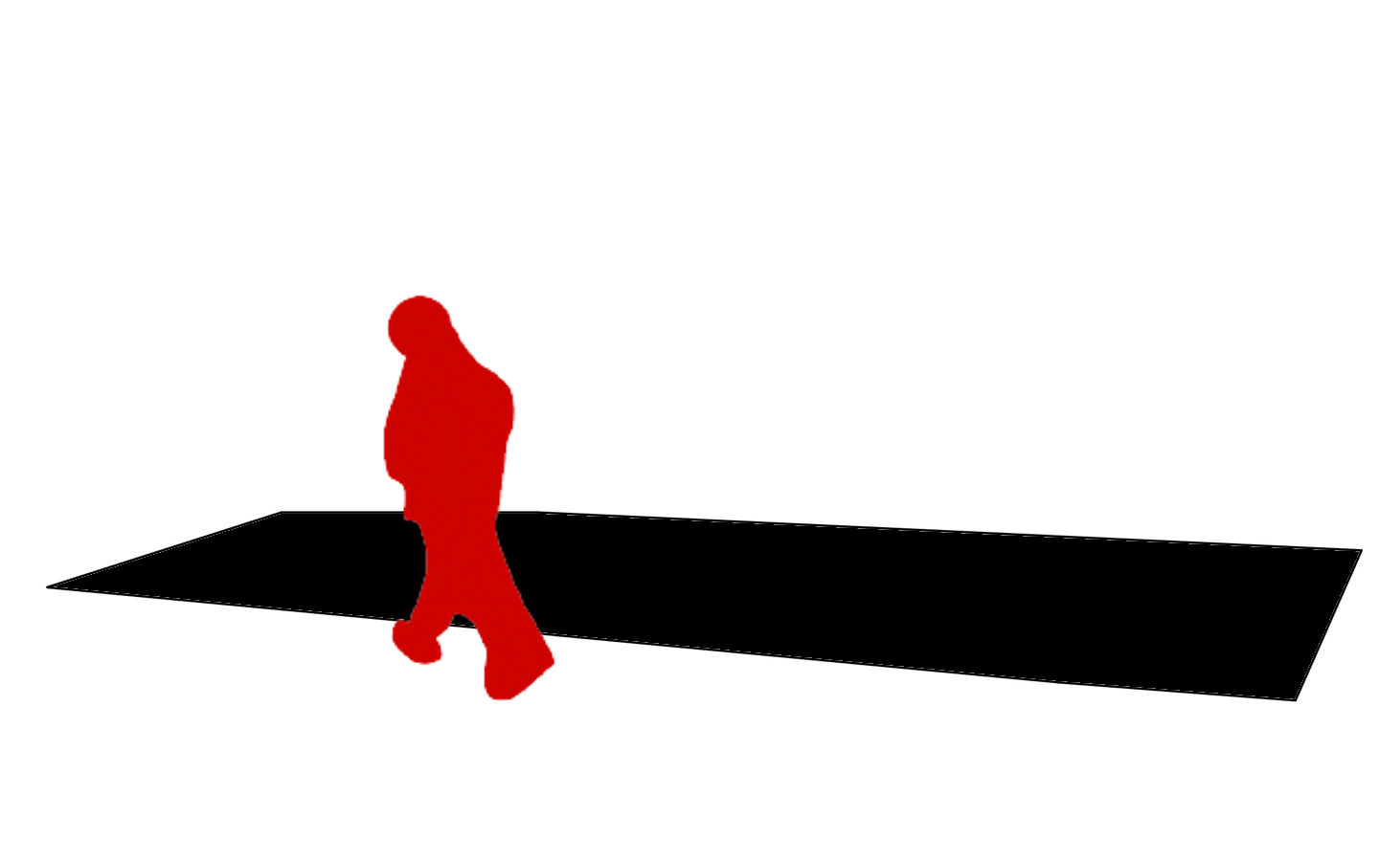
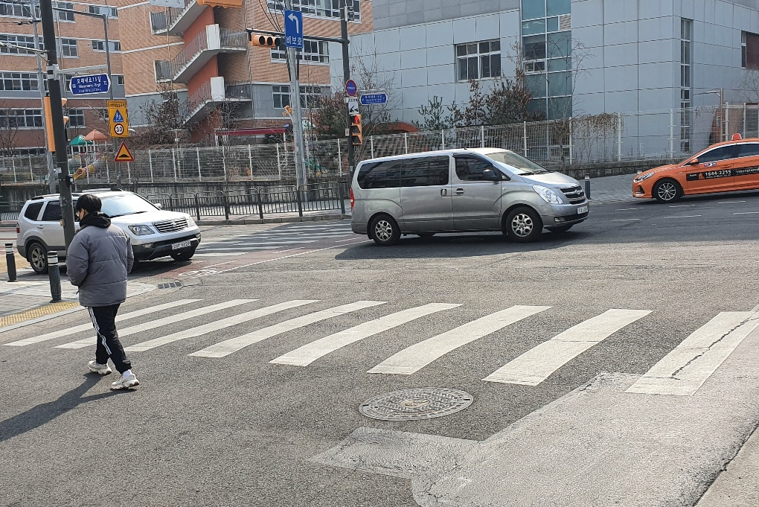
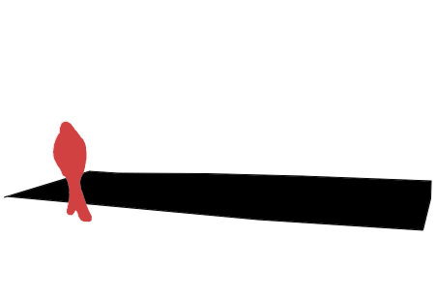
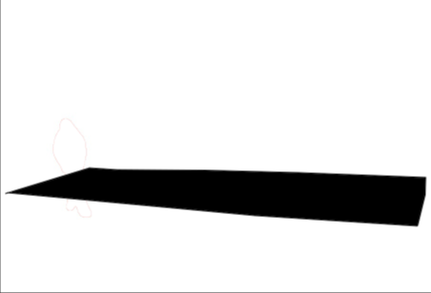
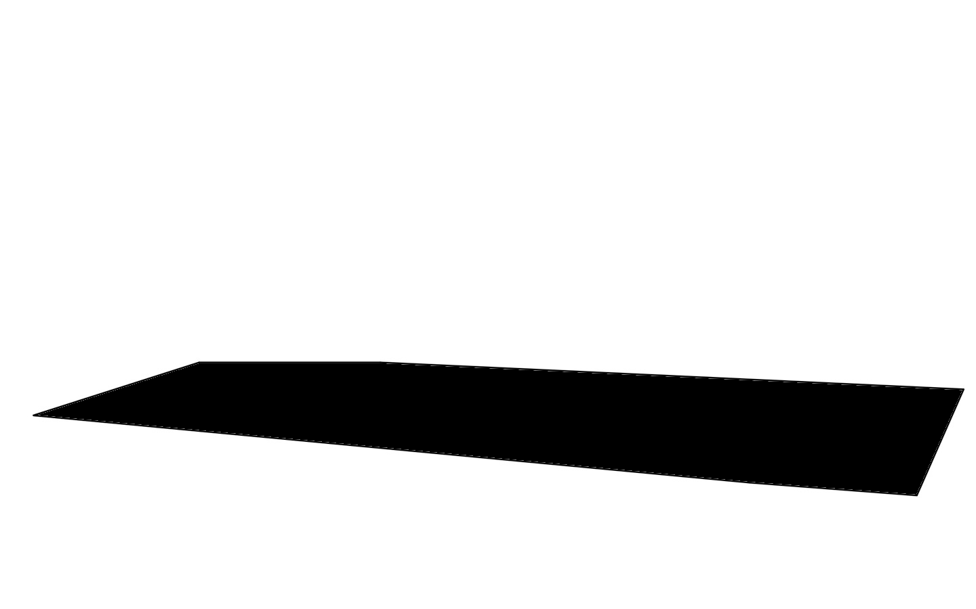
Learning Data :
Test Data :
Mask R-CNN
CNN Model
for Prediction
Object Mask Image
Normal Image
User
Direct designation
Composite Image
Predict
state of the object
Crosswalk Area Image
Stage 1 : 데이터 만들기
Stage 2 : 학습
Stage 3 : 테스트
541789

Slide 2
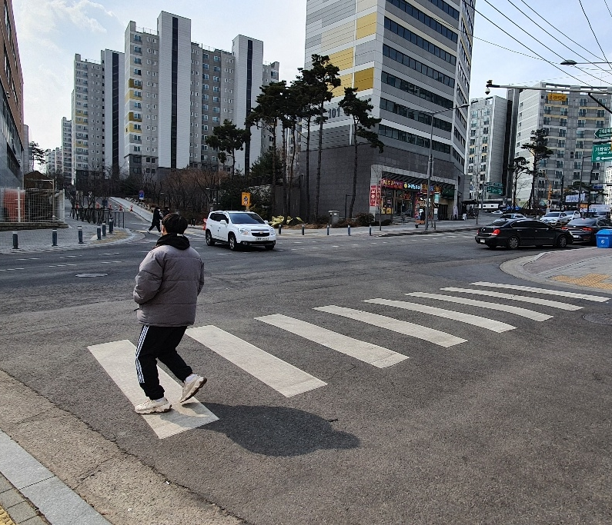
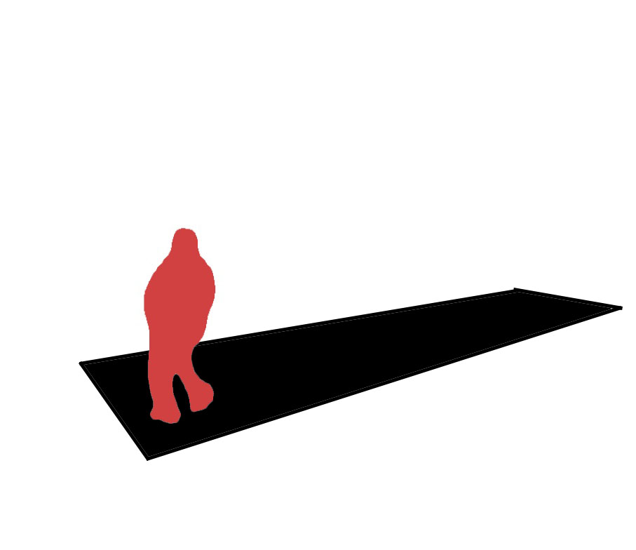
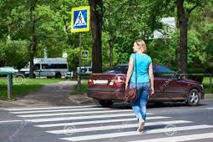
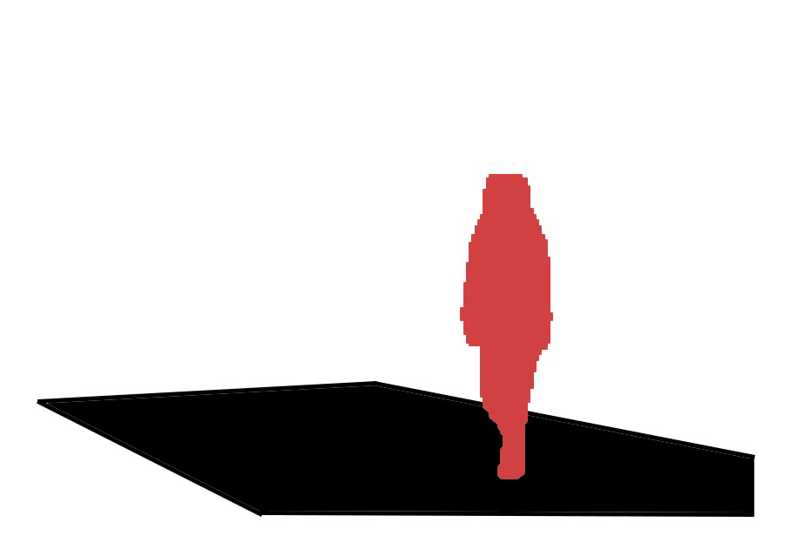
Training
CNN Model
Mask R-CNN
Mask R-CNN
Test
Safety
Danger
Original Images
Masked Images
Data stage
Training & Test stage

Slide 3


Training
CNN Model
Mask R-CNN
Test
Safety
Danger
Original Images
Masked Images

Slide 4



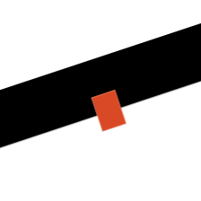
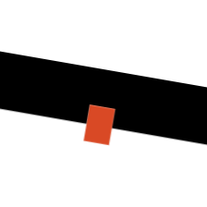
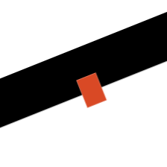

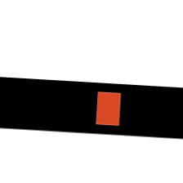
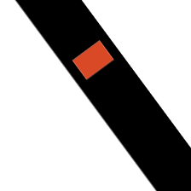




Augmentation
Augmentation

Slide 5
Mask R-CNN
Training
CNN Model
Safety
Danger
Original Images
Masked Images

Slide 6
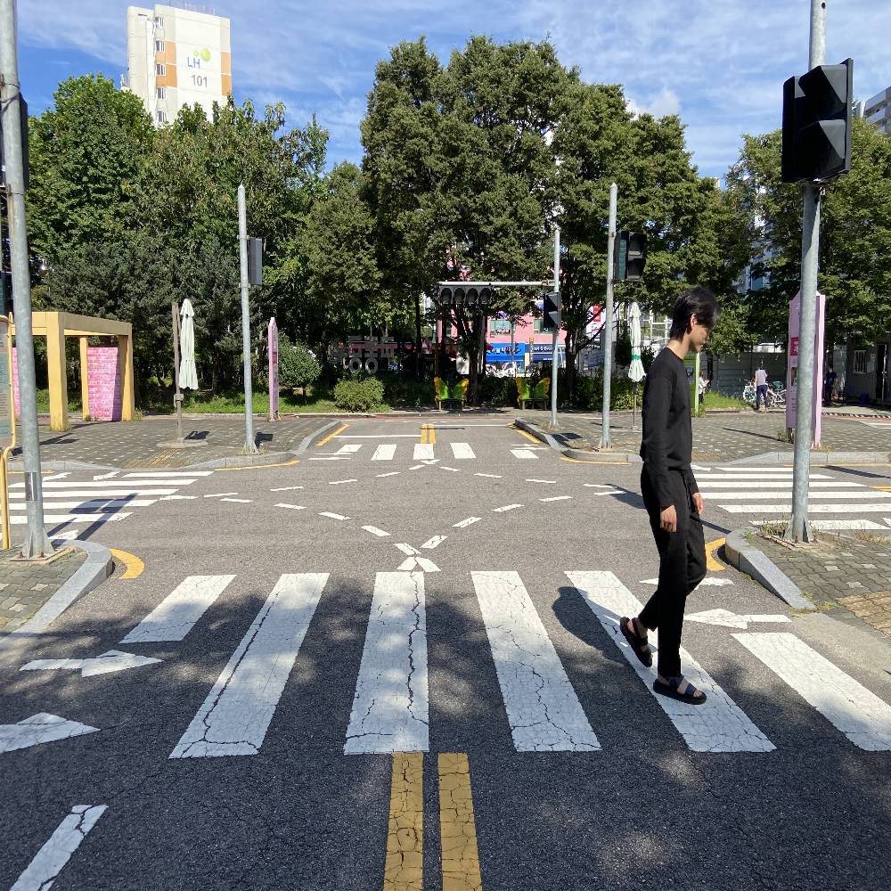

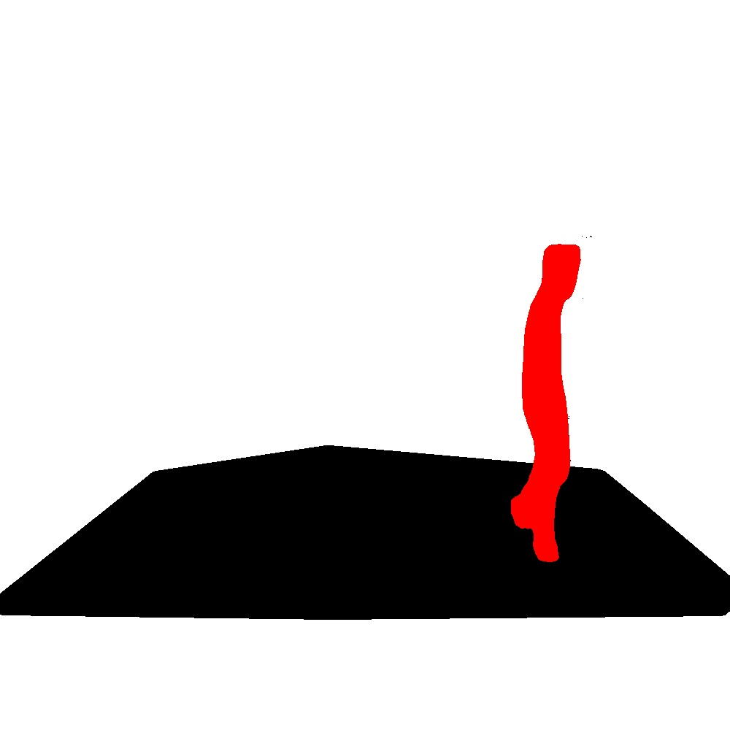
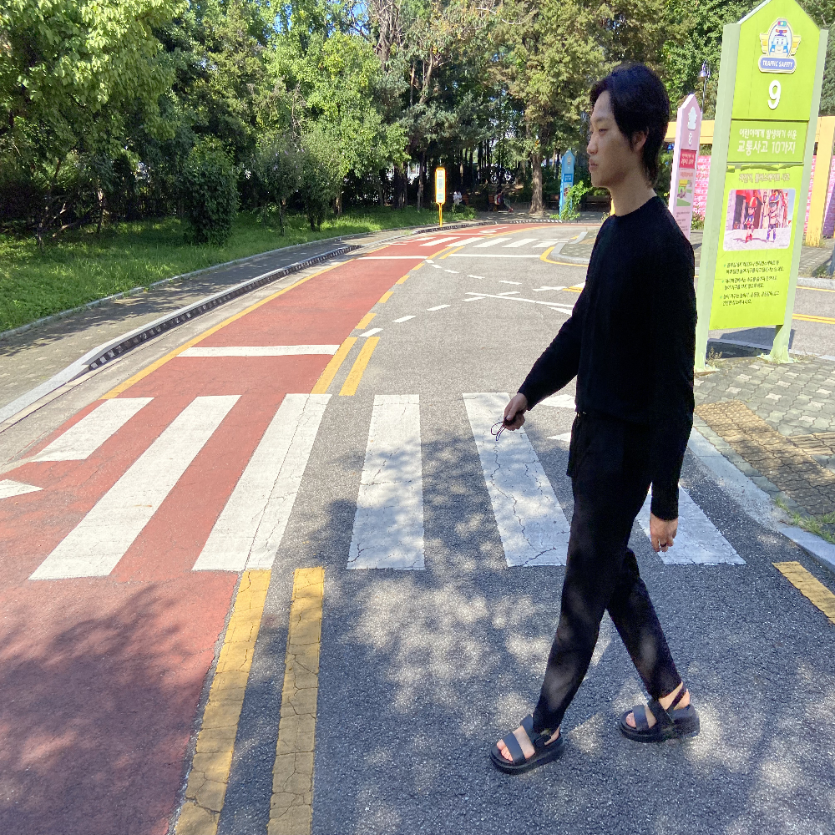
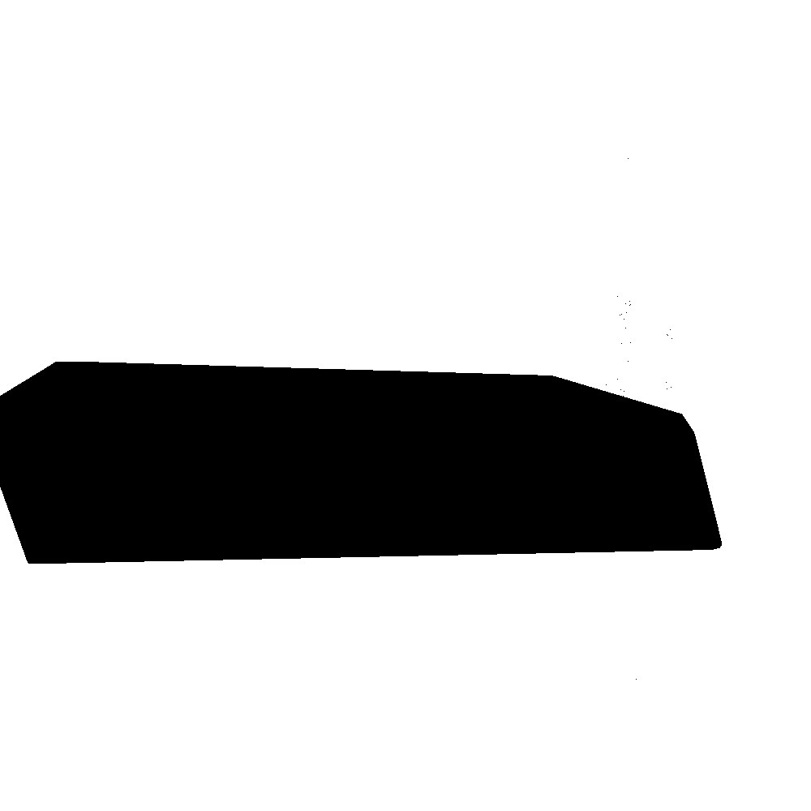
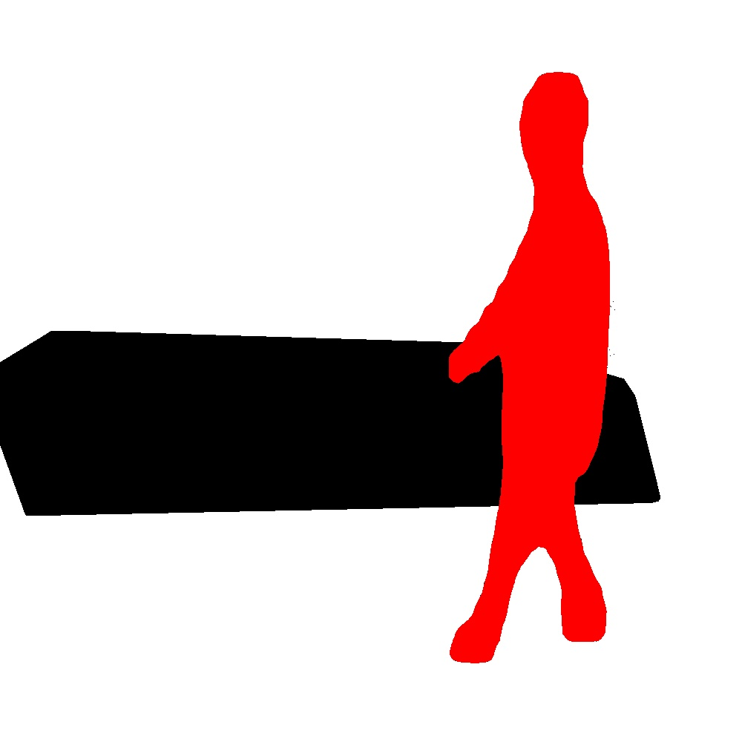
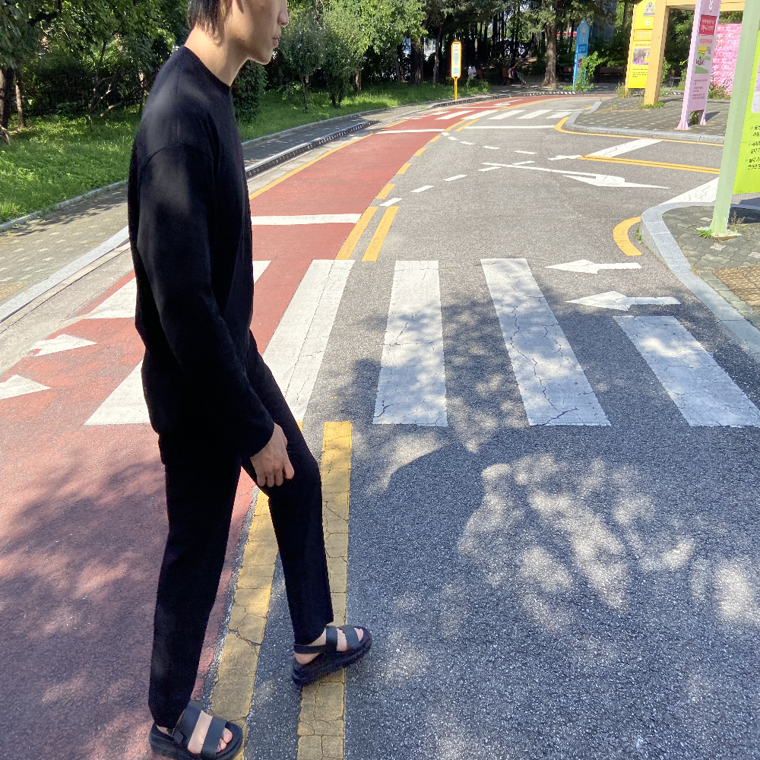
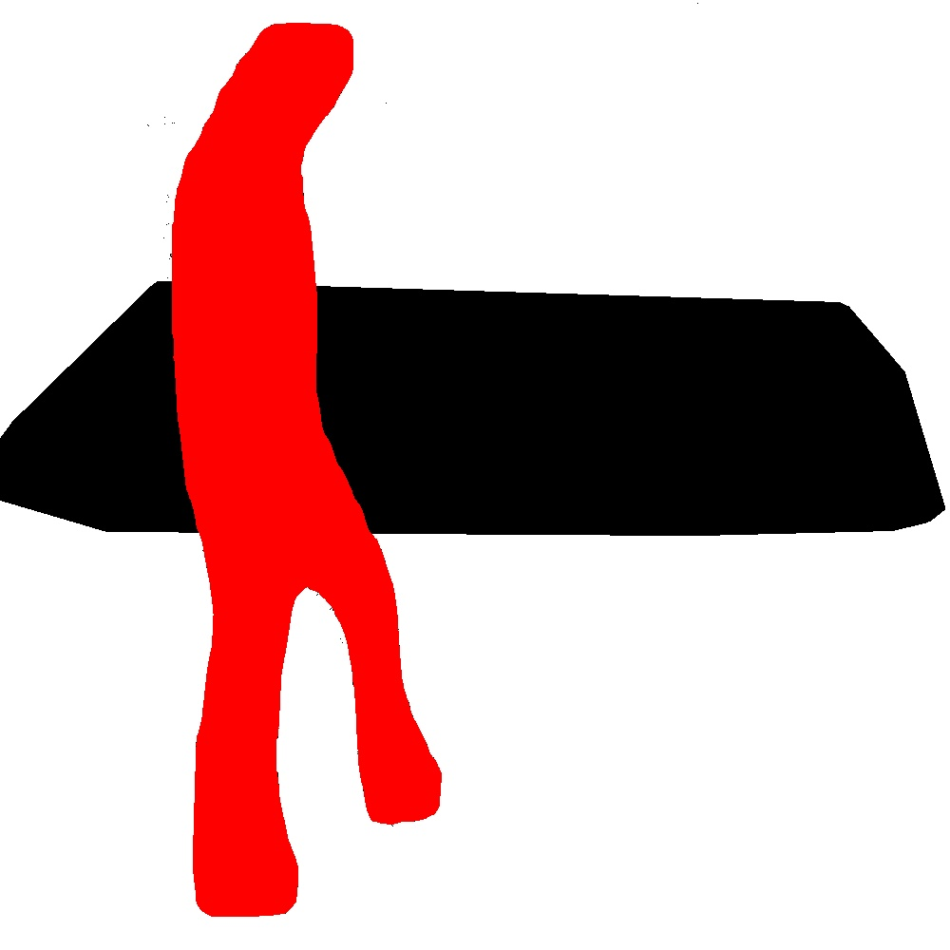
Mask R-CNN
Training
CNN
Crosswalk Detection Algorithm
(CDA)
Train Data
Mask R-CNN
+
Crosswalk Detection Algorithm
Validation
Danger (Out)
Test Data
Safety (In)

Slide 7
Augmentation
Training
CNN
Augmentation
Train Images
Mask R-CNN
+
CDA
Validation
Danger (Out)
Test Images
Safety (In)

Slide 8
Stage 1
Stage 3
Mask R-CNN
Training
CNN
Stage 2
CDA
Original Images
Train Images
Mask R-CNN
+
CDA
Validation
Danger (Out)
Test Images
Safety (In)

Slide 9
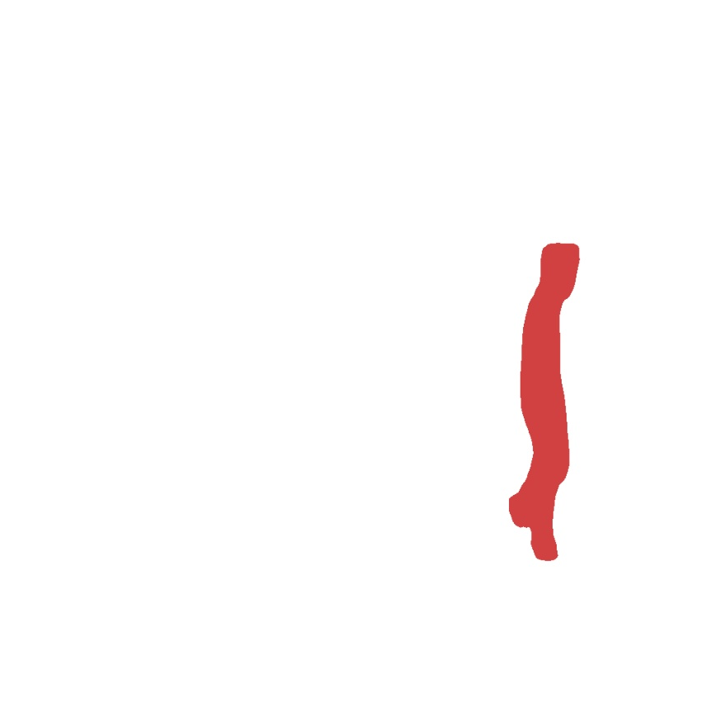
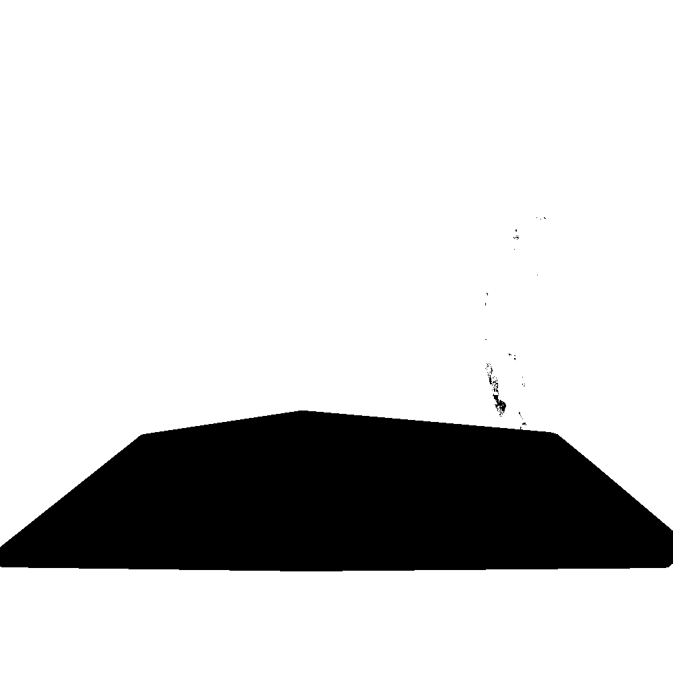
Training
CNN
Mask R-CNN
Crosswalk Detection Algorithm
Inside
Inside
Mask R-CNN
Crosswalk Detection Algorithm
Outside
Outside

Slide 10
Training
CNN
Mask R-CNN
Crosswalk Detection Algorithm
Inside
Inside
Mask R-CNN
Crosswalk Detection Algorithm
Outside
Outside

Slide 11
Crosswalk
Detection
Algorithm
Inside
Inside
Outside
Outside

Slide 12
Mask R-CNN
Inside
Inside
Outside
Outside

Slide 13

Safety situation
Danger situation
Safety situation
Danger situation
Safety situation
Danger situation
a) Original Images
b) Processed Images
(Mask R-CNN, CDA)
c) Box Images

Slide 14
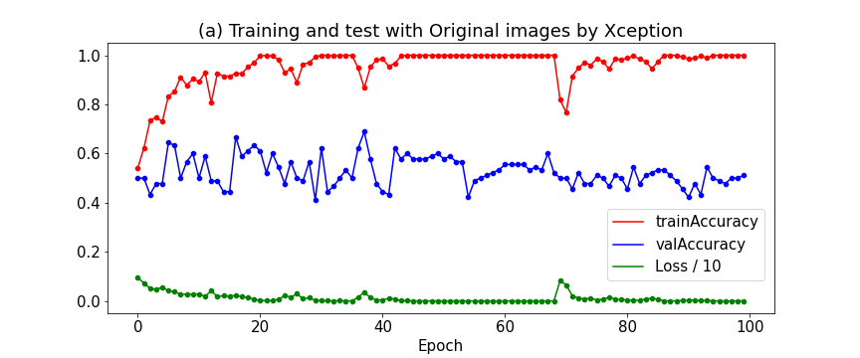
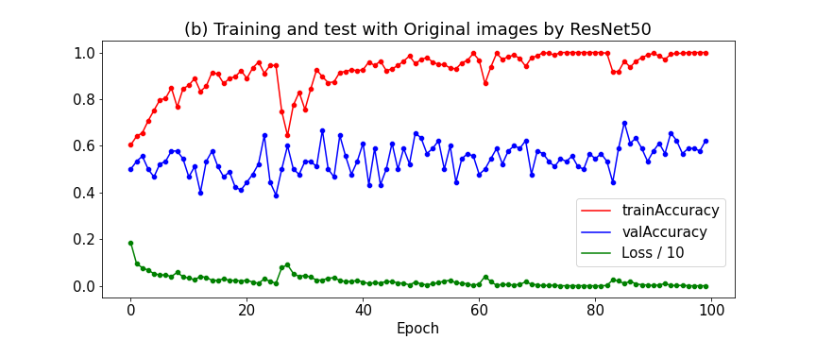
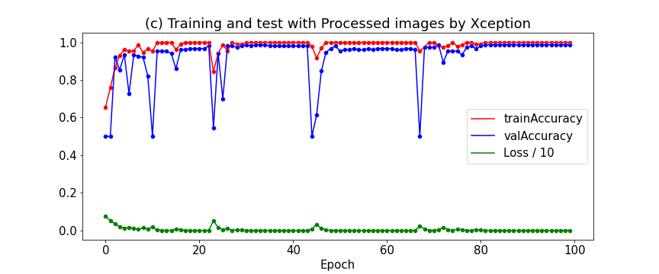
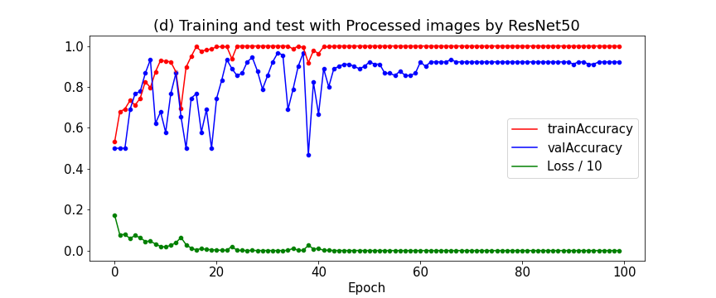
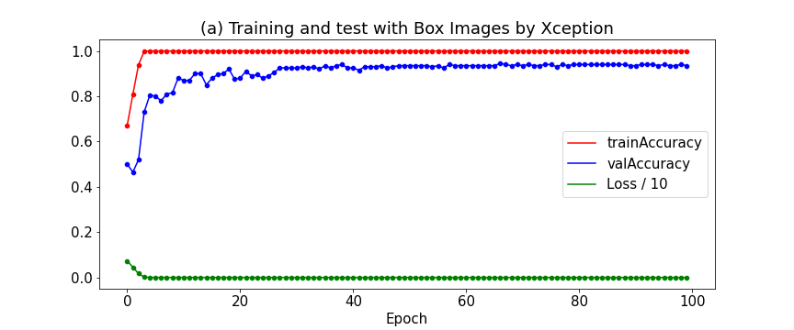
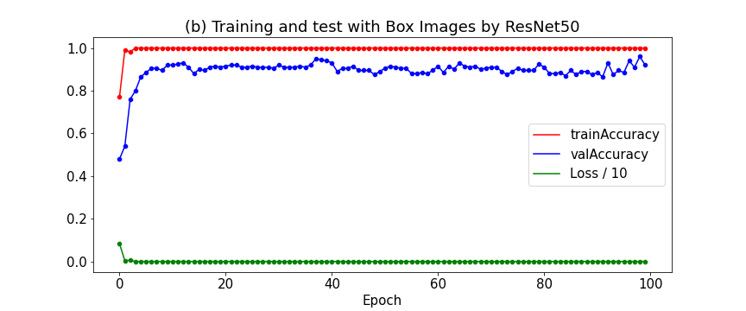

Slide 15
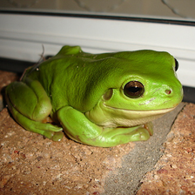


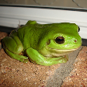
Interpolation
N/M
N
N/M
N

